Slide 1
MEDICAL IMAGE CLASSIFICATION USING CONVOLUTIONAL NEURAL NETWORK
DEEP LEARNING

Slide 2
TABLE OF CONTENTS
01
04
02
05
03
06
Abstract
Simulation/Result
Literature Survey
Conslusion
Future Works & References
Approach

Slide 3
Abstract

Slide 4
ABSTRACT
Project
Medical Image Classification Using Convolutional Neural Network
- Deep Learning
Impact
This Project Helps us in Detecting Different Diseases Using Medical Images Such as X-Rays, CT Scan etc..
Analysis
Upon Analysis Using Medical Image Data Sets We Can Detect The Diseases With Higher Accuracy Using CNN

Slide 6
Literature Survey

Slide 10
Approach

Slide 11
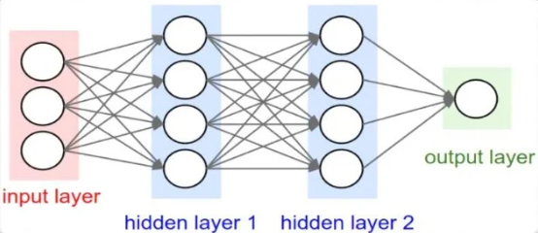
Neural Networks
A computational model that works in a similar way to the neurons in the human brain.
Each neuron takes input, performs some operations then passes the output to the following neuron.
A powerful technique to solve many real world problems.
Neural Networks
Architecture

Slide 12
What is CNN?
It is a subset of deep learning.
Convolutional neural network (Convnet or CNN) is one main categories to do images recognition, images classification, object detections, face recognition etc.
CNN is heavily based on computer vision.
There are 3 basic components to define CNN:
1. The Convolution Layer
2. The Pooling Layer
3. The Output Layer (or) Fully Connected Layer

Slide 13
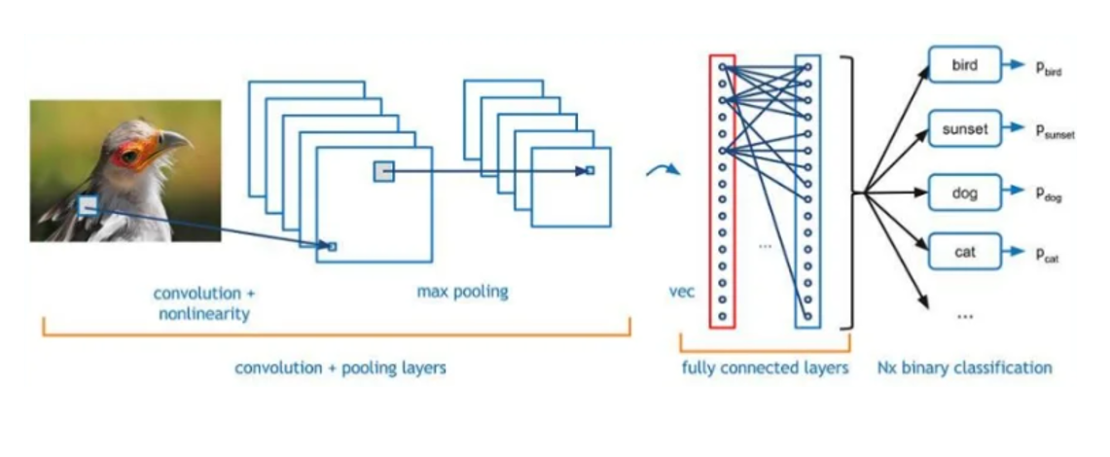
Architecture of CNN

Slide 14
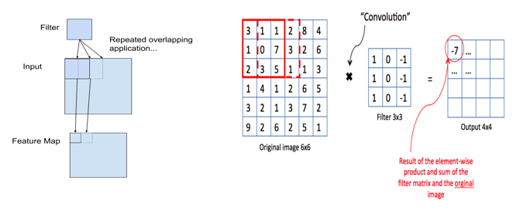
Convolution Layer
The Convolutional Layer makes use of set of filters. A filter is used to detect the presence of specific features or patterns in the original image(input).

Slide 15
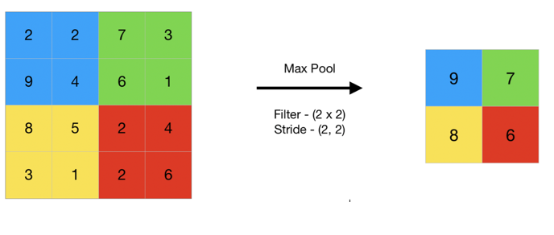
Pooling Layer
The Pooling Layer is seen in between the convolution layers in CNN architecture.
Pooling is done for sole purpose of reducing the spatial size of the image.

Slide 16
Pooling Layer
The Pooling Layer is seen in between the convolution layers in CNN architecture.
Pooling is done for sole purpose of reducing the spatial size of the image.

Slide 17
The Output Layer (or) Fully Connected Layer
The term "Fully Connected" implies that every neuron in the previous layer is connected to every neuron on the next layer.
The output from the convolutional and pooling layers represents high level features of the input image.
The purpose of the fully connected layer is to use these features for classifying the input image into various classes based on the training dataset.

Slide 18
Simulation & Result

Slide 19
As we can see from the approach that we are using three layers of CNN to Classify the images of different diseases.
We are trying to detect the COVID-19 and Pneumonia using CNN models.

Slide 20
Technologies Used
Vs Code
Python
Kaggle
For Coding Purpose and it is streamlined code editor with operations like debugging, task, running
Python offers concise and readable code. Python’s simplicity allows us write complex codes easily because of many libraries. Such as Pandas etc.
Kaggle is an online platform for finding different image datasets for analysis.

Slide 21
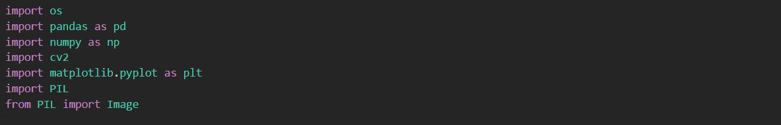
Covid-19 Detection Using CNN Libraries Used In Our Code: Kaggle Dataset Imported: tawsifurrahman/covid19-radiography-database

Slide 22
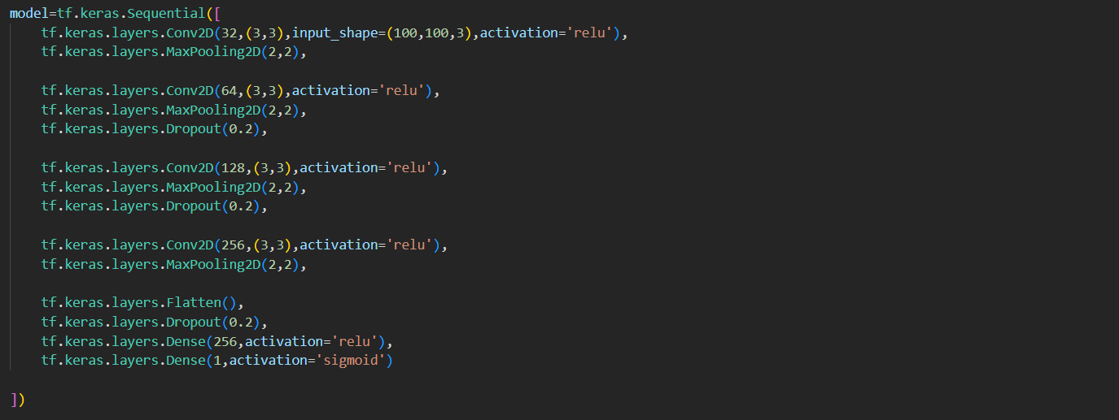
Covid-19 Detection Using CNN Developing a Convolutional Neural Network for the classification task: CNN Layers Model:

Slide 23
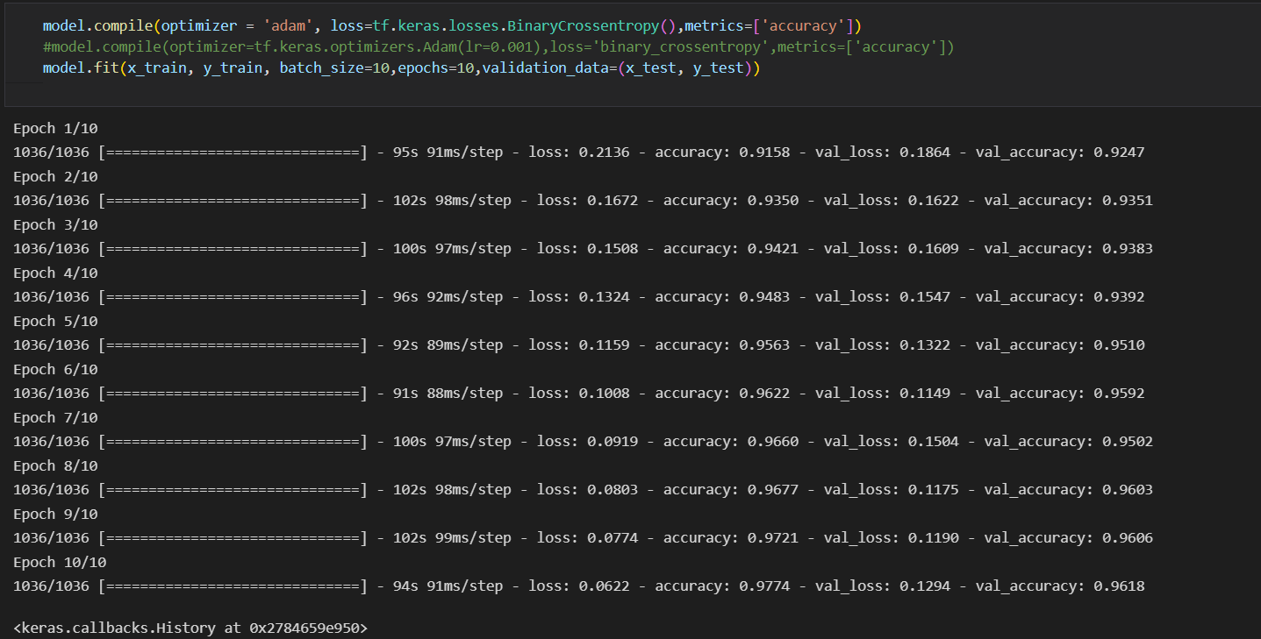
Covid-19 Detection Using CNN Training CNN Model Using The Training, Validation Datasets: The Accuracy is Increasing and Loss is decreasing based on number of iterations.

Slide 24
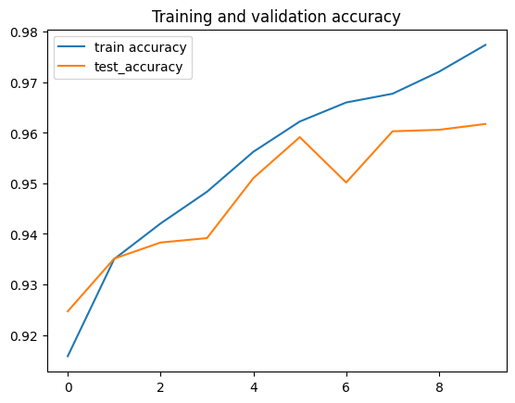
Covid-19 Detection Using CNN
Training and
Validation Accuracy
Result:
As We Can See The
Training and
Validation Accuracy
is Increasing as the
Iterations/Epoch are
increasing

Slide 25
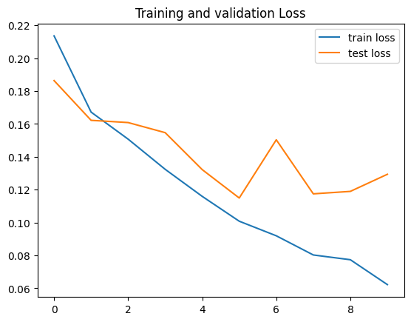
Covid-19 Detection Using CNN
Training and
Validation Loss
Result:
As We Can See The
Training Loss and
Validation Loss is
Decreasing as the
Iterations/Epoch are
increasing

Slide 26
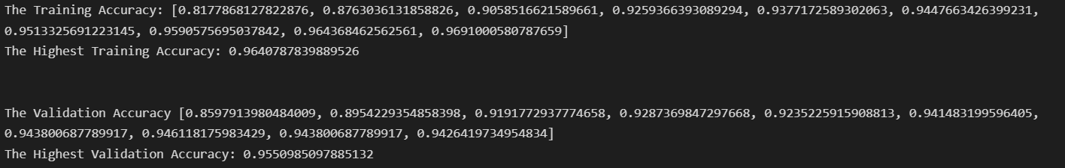
Covid-19 Detection Using CNN Result: The Highest Training and Validation Accuracy Obtained:

Slide 27
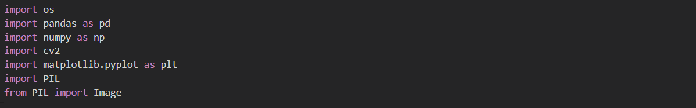
Pneumonia Detection Using CNN
Libraries Used In Our Code:
Kaggle Dataset Imported: jtiptj/chest-xray-pneumoniacovid19tuberculosis

Slide 28
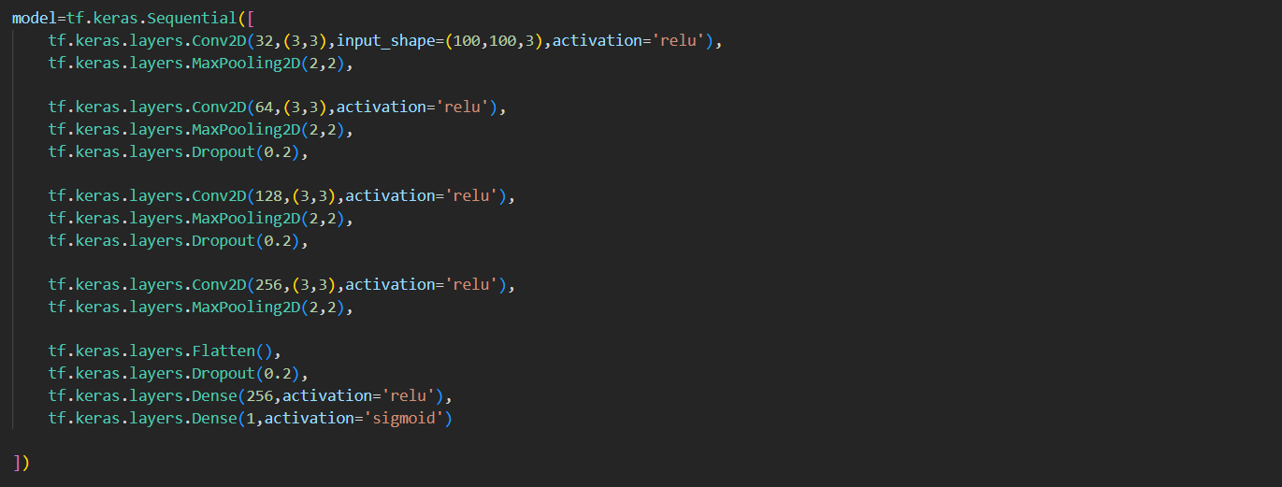
Pneumonia Detection Using CNN
Developing a Convolutional Neural Network for the classification task:
CNN Layers Model:

Slide 29
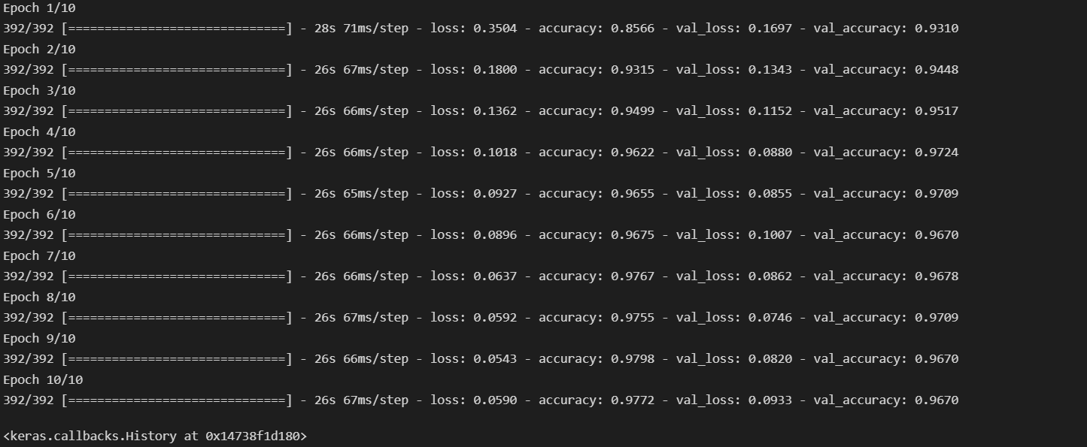
Pneumonia Detection Using CNN
Training CNN Model Using The Training, Validation Datasets:
The Accuracy is Increasing and Loss is decreasing based on number of iterations.

Slide 30
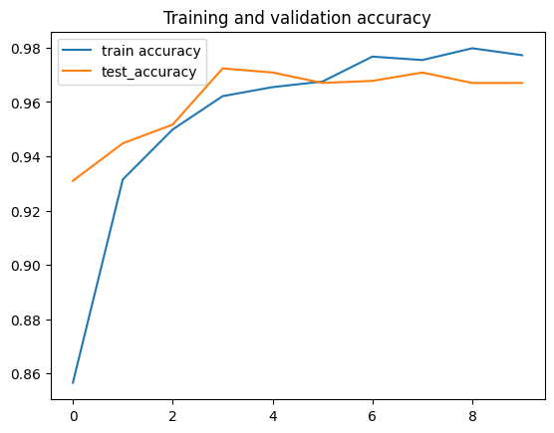
Pneumonia Detection Using CNN
Training and
Validation Accuracy
Result:
As We Can See The
Training and
Validation Accuracy
Increasing as the
Iterations/Epoch are
increasing

Slide 31
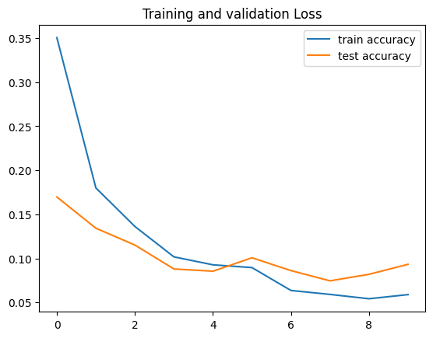
Pneumonia Detection Using CNN
Training and
Validation Loss
Result:
As We Can See The
Training Loss and
Validation Loss is
Decreasing as the
Iterations/Epoch are
increasing

Slide 32
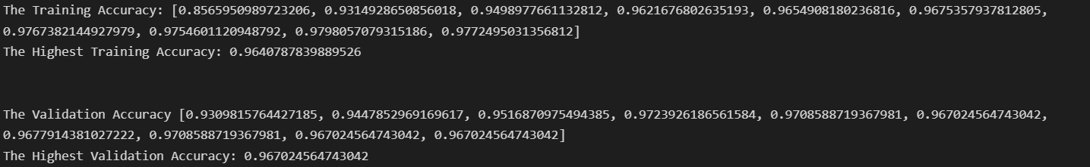
Pneumonia Detection Using CNN Result: The Highest Training and Validation Accuracy Obtained:

Slide 33
Conclusion

Slide 35
Future Works

Slide 37
PROJECT STAGES
Stage 3
Stage 2
Mercury is the closest planet to the Sun and the smallest one
Stage 1
Despite being red, Mars is actually a cold place. It’s full of iron oxide dust
Venus has a beautiful name and is the second planet from the Sun

Slide 38
References
[1] Hybrid deep learning for detecting lung diseases from X-ray Images. Subrato Bharati, Prajoy Podder, M. Rubaiyat Hossain Mondal.
[2] Lung cancer medical images classification using Hybrid CNN-SVM. Abdulrazak Yahya Saleh, Chee Ka Chin, Vanessa Penshie, Hamada Rasheed Hassan Al-Absi.
[3] Lung Nodule Detection based on Faster R-CNN Framework. Ying Su, Dan Li, Xiaodong Chen.
[4] TX-CNN: Detecting Tuberculosis in chest X-Ray images using Convolutional Neural Network. Chang Liu, Yu Cao, Marlon Alcantara, Benyuan Liu, Maria Brunette, Jesus Peinado, Walter Curioso.
[5] Learning distinctive filters for COVID-19 detection from chest X-ray using shuffled residual CNN. R. Karthik, R. Menaka, Hariharan M.

Slide 39
Thank You !!

